Slide 1

DIGITAL PORTFOLIO
STUDENT NAME: A. Nishanthini
REGISTER NO & NMID: asunm1753222411560
DEPARTMENT: B.SC Computer Science
COLLEGE: Madras university
Why XAI Matters
AI is making critical decisions: healthcare, finance, law, defense.
Problem: Black box models hide their logic.
Lack of explainability → low trust, bias, legal risk.
XAI is the bridge: makes AI human-understandable.

Slide 2

Explainable AI (XAI):
Turning Black Boxes into Glass Boxes
PRESENTED BY: Nishanthini,
Dhanalakshmi & Sowmiya
COLLEGE: Jaya Women’s College of Arts and Science
EVENT NAME: TECK ATICK 2K25 – National Level
Technical Symposium
DATE:26.08.2025
PROJECT TITLE:
PROFESSIONAL
DIGITAL PORTFOLIO
What is Explainable AI?
Definition: Methods that interpret and justify AI outputs.
Combines ML, HCI, ethics, visualization.
Goal: Transparency, interpretability, trust.
Moves AI from “prediction only” → prediction + reasoning.

Slide 3

Why XAI Matters
AI is making critical decisions: healthcare, finance, law, defense.
Problem: Black box models hide their logic.
Lack of explainability → low trust, bias, legal risk.
XAI is the bridge: makes AI human-understandable.
AGENDA:
1.Problem Statement
2. Project Overview
3.End Users
4. Tools and Technologies
5.Portfolio design and Layout
6. Features and Functionality
7.Results and Screenshots
8.Conclusion
9.Github Link
Why Do We Need It?
Regulation: EU’s GDPR demands “right to explanation”.
Risk reduction: AI errors can cost lives/money.
Ethics: Prevent bias and discrimination.
Debugging: Helps data scientists improve models.
User trust = Higher adoption.

Slide 4

What is Explainable AI?
Definition: Methods that interpret and justify AI outputs.
Combines ML, HCI, ethics, visualization.
Goal: Transparency, interpretability, trust.
Moves AI from “prediction only” → prediction + reasoning.
PROBLEM STATEMENT:
In today’s competitive tech industry, having a traditional resume is no longer sufficient to stand out. Recruiters and hiring managers look for candidates who can showcase their skills, projects, and certifications online in a professional and interactive manner. This project addresses the need for a digital platform where a computer science student can present their technical expertise and achievements in a visually appealing and organized format.
Real-World Impact
Healthcare: Explaining cancer diagnosis (feature heatmaps).
Finance: Loan approval with clear reasons.
Self-driving cars: Post-incident analysis.
Defense & Law: Transparent, auditable AI.
Cybersecurity: Explaining anomaly detection.

Slide 5

Why Do We Need It?
Regulation: EU’s GDPR demands “right to explanation”.
Risk reduction: AI errors can cost lives/money.
Ethics: Prevent bias and discrimination.
Debugging: Helps data scientists improve models.
User trust = Higher adoption.
PROJECT OVERVIEW:
The project involves creating a web-based digital portfolio that highlights my skills, projects, internships, and certificates. Built using HTML, CSS, and JavaScript, this portfolio combines modern design elements with interactive functionality. It serves as a centralized platform to present my professional and technical capabilities in web development and AI/ML to potential recruiters and peers.
.
Challenges in XAI
Deep learning = millions of parameters. Hard to simplify.
Accuracy vs. Explainability trade-off.Different users need different detail levels (developer vs. end-user).
Adversarial risk: Too much explanation can reveal secrets.
No single global standard yet.

Slide 6

Real-World Impact
Healthcare: Explaining cancer diagnosis (feature heatmaps).
Finance: Loan approval with clear reasons.
Self-driving cars: Post-incident analysis.
Defense & Law: Transparent, auditable AI.
Cybersecurity: Explaining anomaly detection.
END USERS
This digital portfolio is designed for multiple end users including recruiters, internship coordinators, and mentors who are evaluating my technical skills and projects. Additionally, it serves as a reference for fellow students and peers in the field of computer science, who may seek inspiration or guidance in creating their own professional portfolios.
Key Techniques in XAI
LIME – Local surrogate models to explain predictions.
SHAP – Game theory-based feature attribution.
Counterfactuals – “What if this input changed?”
Saliency/Attention Maps – Visual explanation for images/text.
Rule-based Models & Decision Trees – Human-readable.

Slide 7

Challenges in XAI
Deep learning = millions of parameters. Hard to simplify.
Accuracy vs. Explainability trade-off.Different users need different detail levels (developer vs. end-user).
Adversarial risk: Too much explanation can reveal secrets.
No single global standard yet.
TOOLS
AND TECHNOLOGIES:
The development of this portfolio utilized core web technologies including HTML, CSS, and JavaScript. React was incorporated for interactive components and dynamic UI features. GitHub was used for version control and hosting the project online, while design tools such as VS Code and high-quality images from Unsplash helped create a modern and visually appealing layout.
How Does It Work?
Pre-model explainability: Data analyHowsis & feature selection.
Post-model explainability: Explaining trained models.
Methods:Feature importance scores.Visualization (heatmaps, graphs).
Natural language justification.
Example: “Loan rejected due to low income & high credit usage.”---

Slide 8
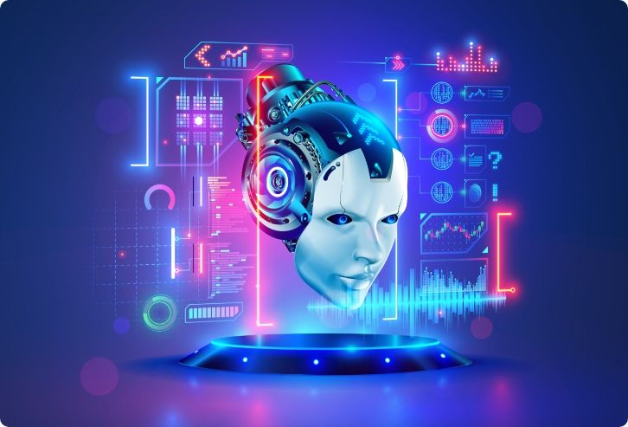
Key Techniques in XAI
LIME – Local surrogate models to explain predictions.
SHAP – Game theory-based feature attribution.
Counterfactuals – “What if this input changed?”
Saliency/Attention Maps – Visual explanation for images/text.
Rule-based Models & Decision Trees – Human-readable.
PORTFOLIO DESIGN
AND
LAYOUT
The portfolio is organized into multiple sections including Home, About Me, Skills, Projects, Certificates, and Contact. The Home section introduces me with a photo and a brief overview, while the Skills and Projects sections use icon-based grids to showcase my abilities. Certificates are presented in a dedicated section highlighting courses in Python, IBM Web Development, and web technologies. A contact section provides links to email, LinkedIn, GitHub, and a downloadable resume. The design features a dark theme with neon glowing titles, providing a professional and modern look.
XAI Tools & Ecosystem
IBM AI Explainability 360 (AIX360) – Open-source.
Microsoft InterpretML – Interactive dashboards.
Google What-If Tool – Visual model testing.
H2O Driverless AI – Enterprise ML with explanations.
DARPA XAI Program – Pioneering research in military AI.

Slide 9

How Does It Work?
Pre-model explainability: Data analyHowsis & feature selection.
Post-model explainability: Explaining trained models.
Methods:Feature importance scores.Visualization (heatmaps, graphs).
Natural language justification.
Example: “Loan rejected due to low income & high credit usage.”---
FEATURES
AND
FUNCTIONALITY
Key features of the portfolio include interactive skill and project grids, responsive design for mobile and desktop users, and hover effects on cards and titles for enhanced user experience. Users can download my resume directly from the portfolio, and links to LinkedIn and GitHub provide additional professional context. The website also incorporates certificates and internship information to fully demonstrate my technical expertise.
Future of XAI
Mandatory explainability laws likely.
Hybrid AI – human + machine decision-making.
Explainability for deep neural networks (research focus).
Ethical & responsible AI → mainstream demand.
Trustworthy AI = Competitive advantage.

Slide 10
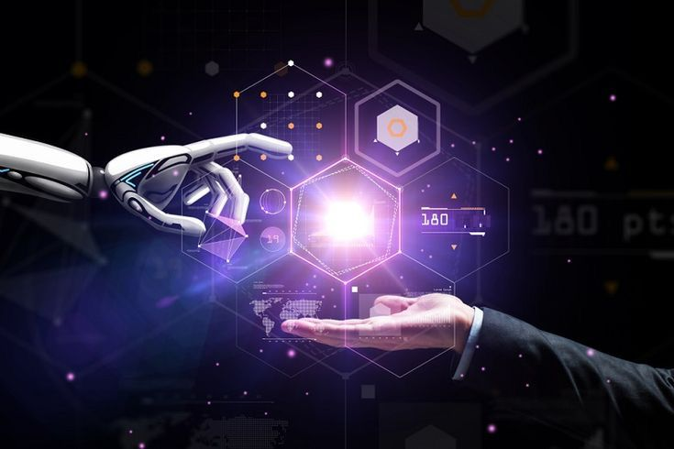
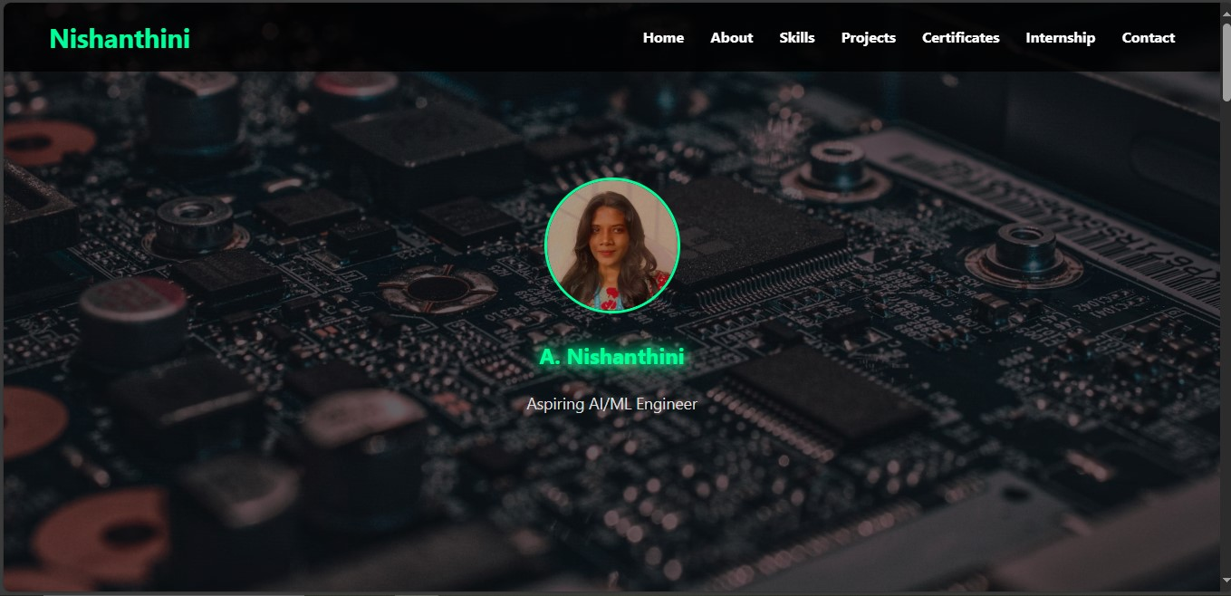
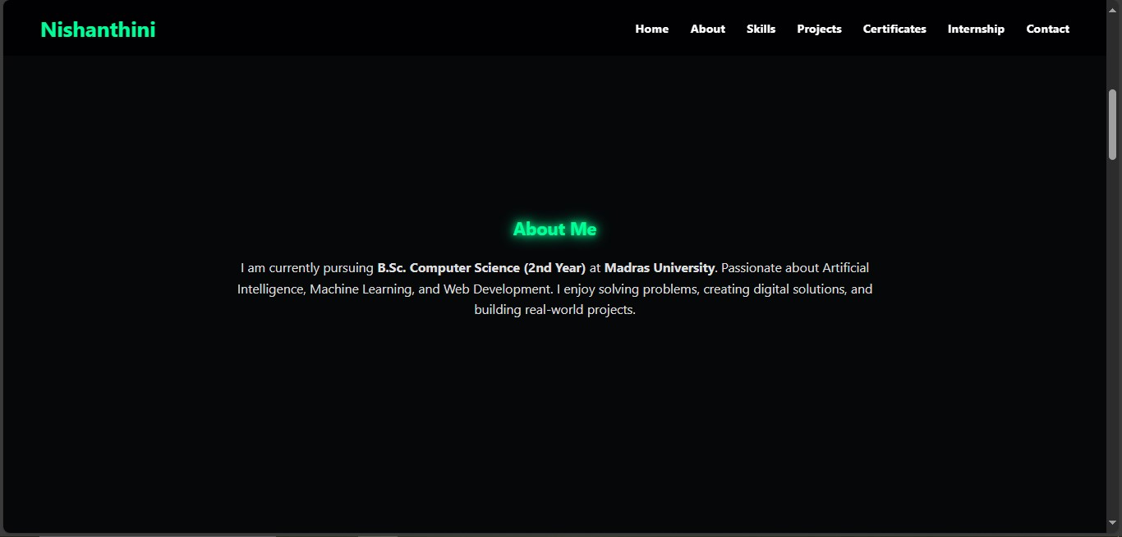
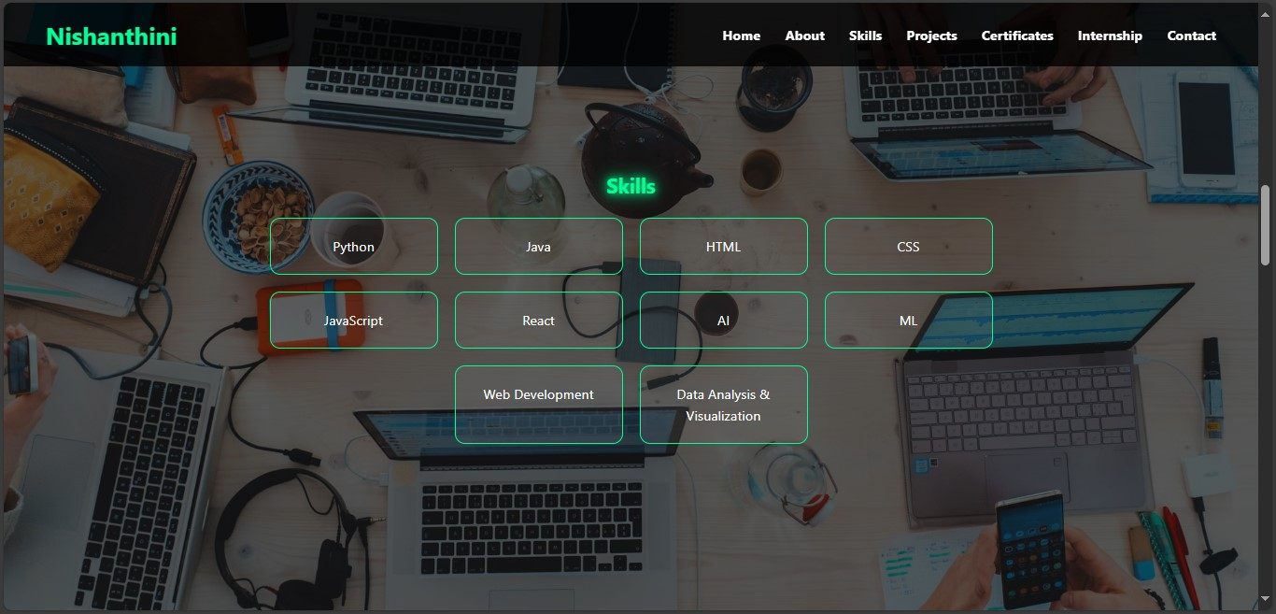
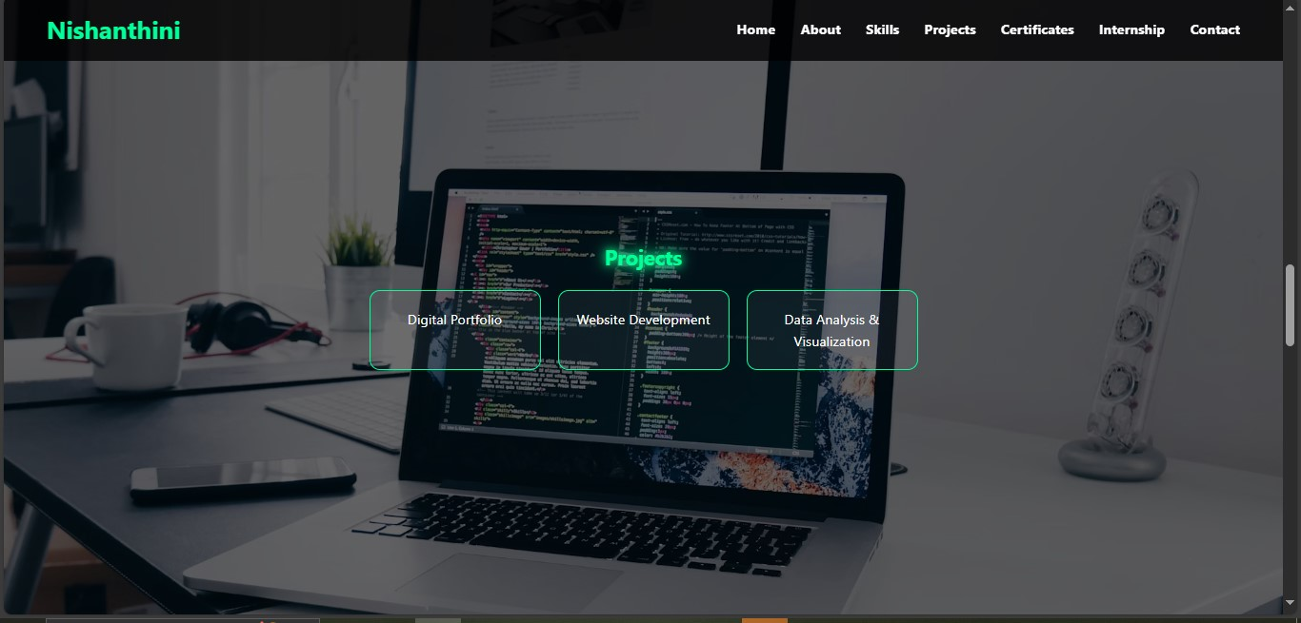
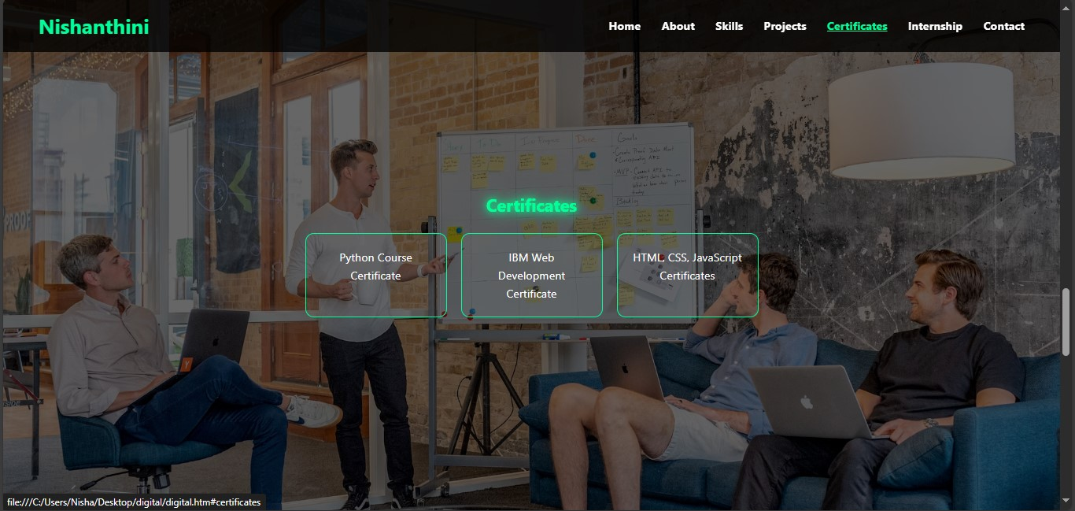

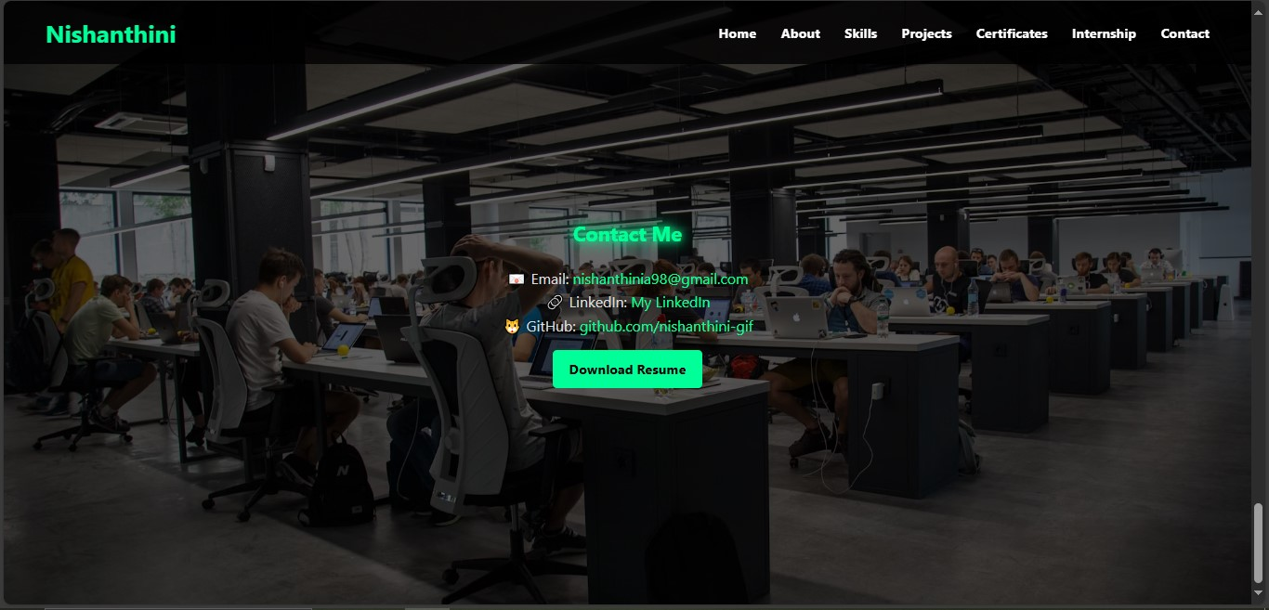
XAI Tools & Ecosystem
IBM AI Explainability 360 (AIX360) – Open-source.
Microsoft InterpretML – Interactive dashboards.
Google What-If Tool – Visual model testing.
H2O Driverless AI – Enterprise ML with explanations.
DARPA XAI Program – Pioneering research in military AI.
RESULTS AND SCREENSHOTS
.
Conclusion
AI is powerful, but trust is the currency.
Opaque models → doubt and risk.
XAI makes AI understandable, ethical, and safe.
Future belongs to transparent, auditable AI systems.

Slide 11

Future of XAI
Mandatory explainability laws likely.
Hybrid AI – human + machine decision-making.
Explainability for deep neural networks (research focus).
Ethical & responsible AI → mainstream demand.
Trustworthy AI = Competitive advantage.
CONCLUSION
conclusion, this project demonstrates my ability to creInate a professional, interactive, and visually appealing digital portfolio. It not only highlights my technical skills in web development and AI/ML but also provides a polished platform to present my projects, certificates, and professional identity. This portfolio serves as a key tool for internships, placements, and professional networking.
Reference
DARPA XAI Program Reports
LIME, SHAP research papers
IBM AIX360, Microsoft InterpretML
IEEE & ACM AI Ethics Journals
Thank You!

Slide 12
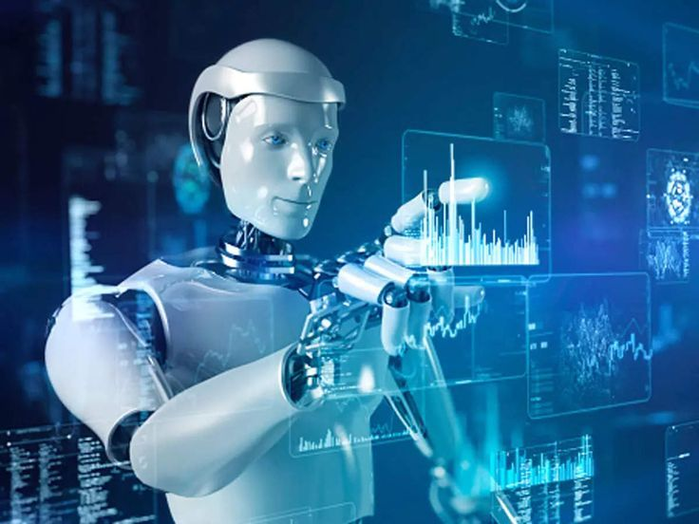
Conclusion
AI is powerful, but trust is the currency.
Opaque models → doubt and risk.
XAI makes AI understandable, ethical, and safe.
Future belongs to transparent, auditable AI systems.
GITHUB LINKS
The complete source code for this project is available on GitHub at https://github.com/nishanthini-gif. Interested viewers can explore the repository to review the implementation details, project structure, and live demonstration of the portfolio website.
THANK YOU!

